Slide 1
My-Portfolio Project
Jason Zhang
URL: http://my-portfolio-alb-180099420.us-east-1.elb.amazonaws.com
Example Alias: zhanxink

Slide 2
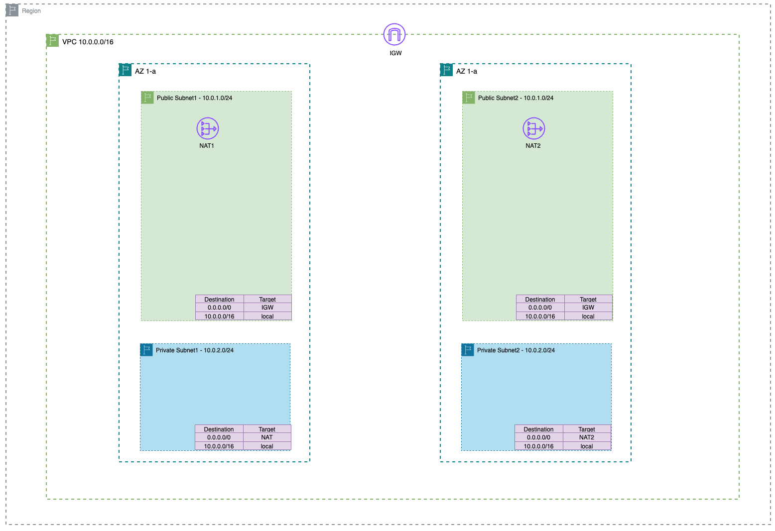
CloudFormation - VPC
http://my-portfolio-alb-180099420.us-east-1.elb.amazonaws.com/efs/zhanxink/Project-4-HAWA-CloudFormation-Code.pdf

Slide 3
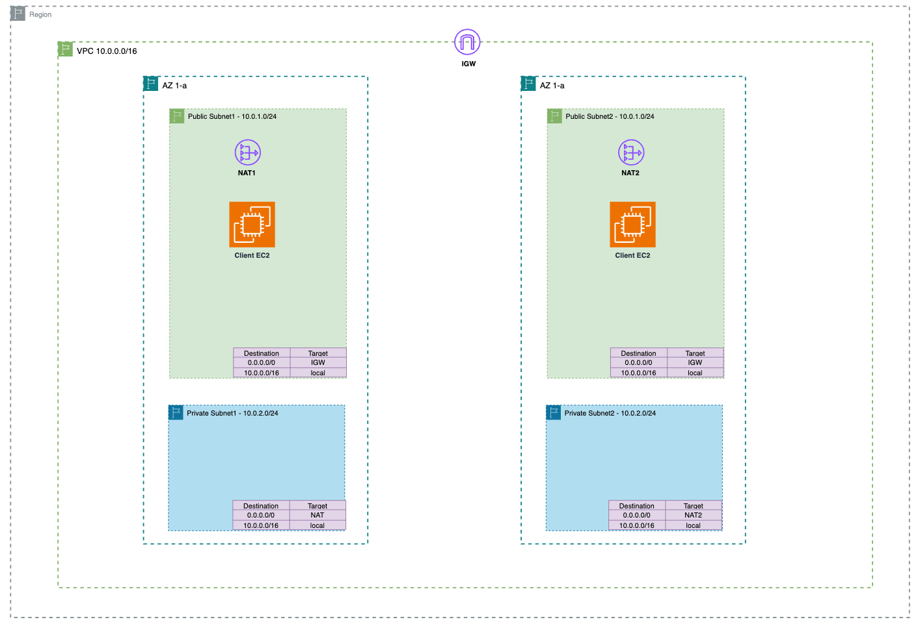
Client EC2 - nginx

Slide 4
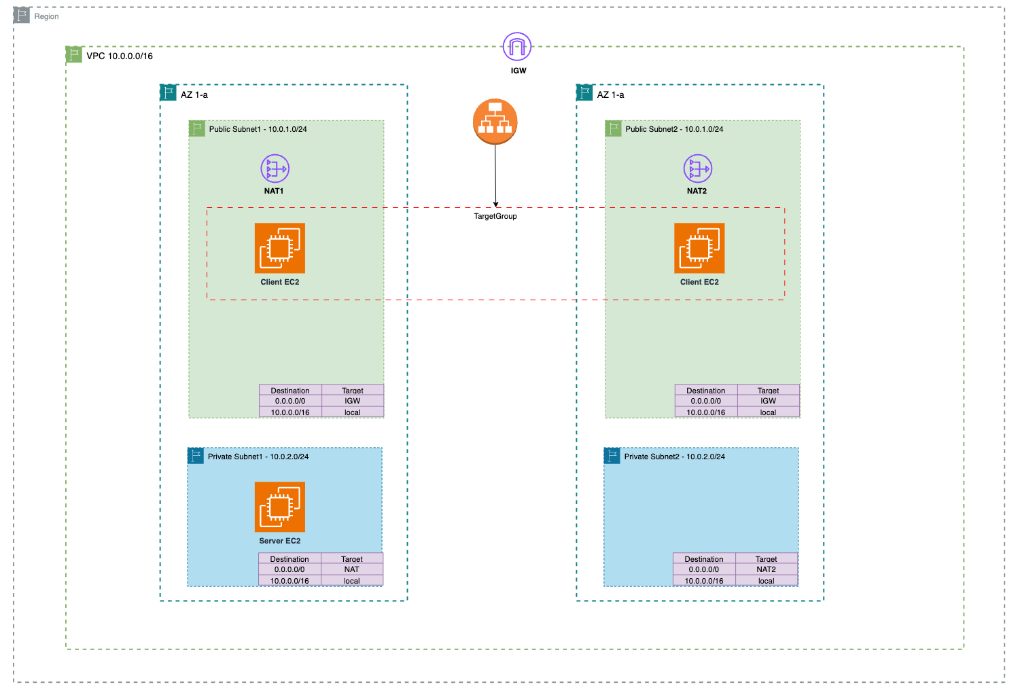
Client EC2 - ALB

Slide 5
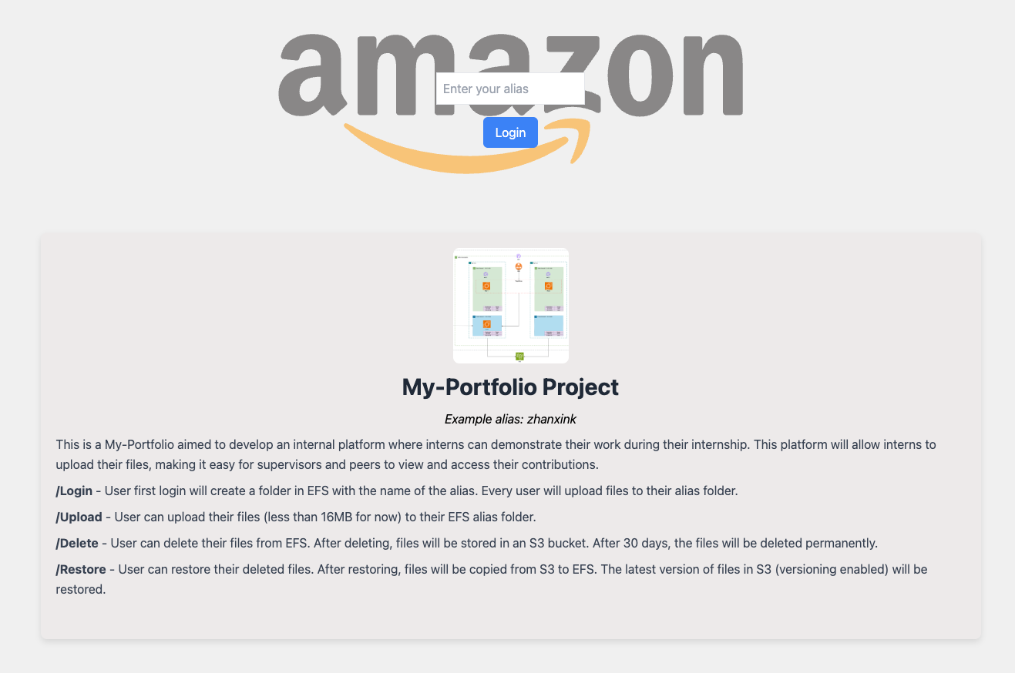
Client EC2 - nginx

Slide 6
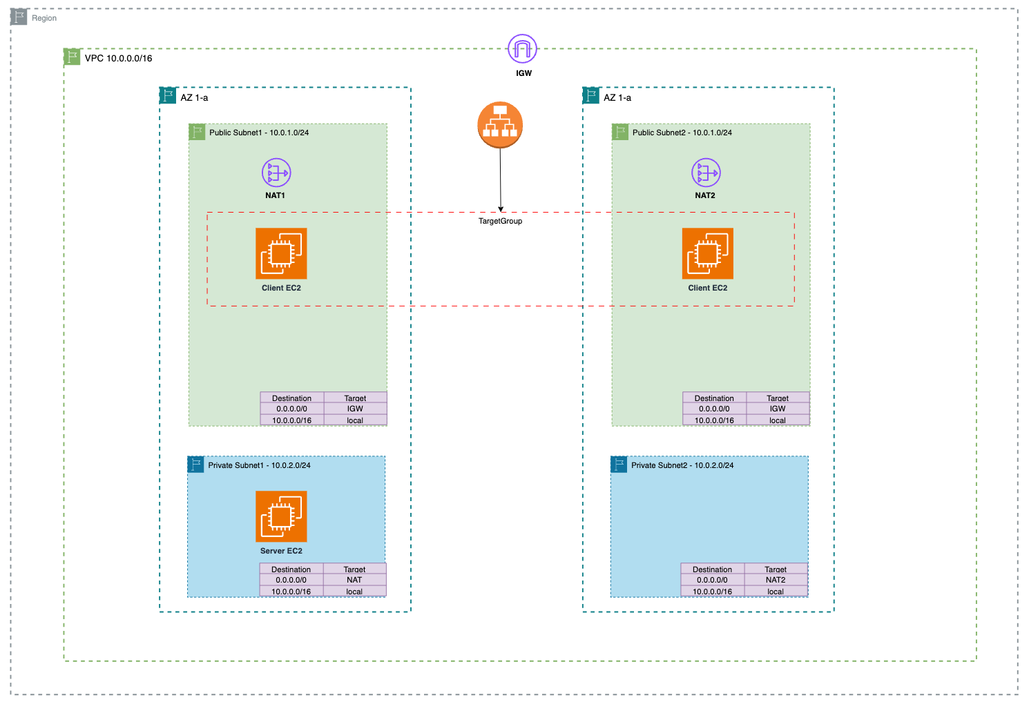
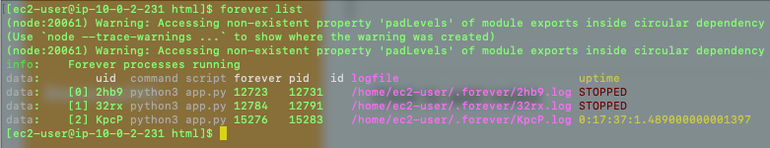
Server EC2 - nginx

Slide 7
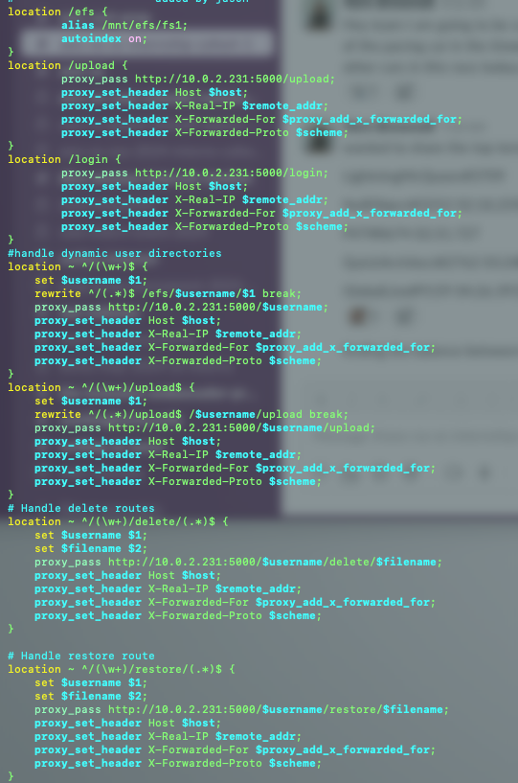
Client EC2 – nginx.conf

Slide 8


Public Subnet 1
10.0.1.0/24
HTTP
SSH
Client
all
Private Subnet 1
10.0.2.0/24
Inbound
Client instance 1
outbound
SSH
HTTP
Server
Public Subnet 2
10.0.3.0/24
inbound
Server instance
HTTP
SSH
Client
all
Inbound
Client instance 2
outbound

Slide 9
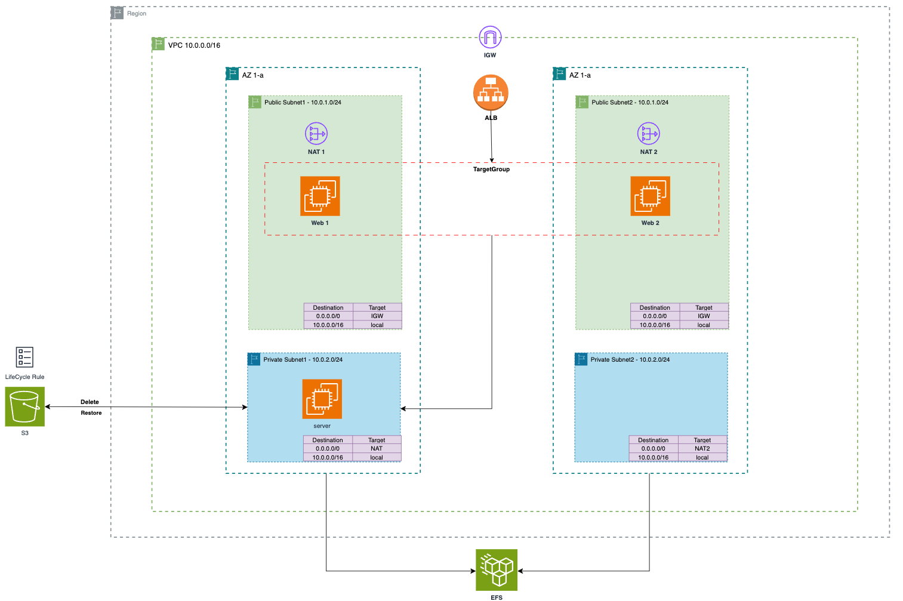
Server EC2 – EFS & S3

Slide 10
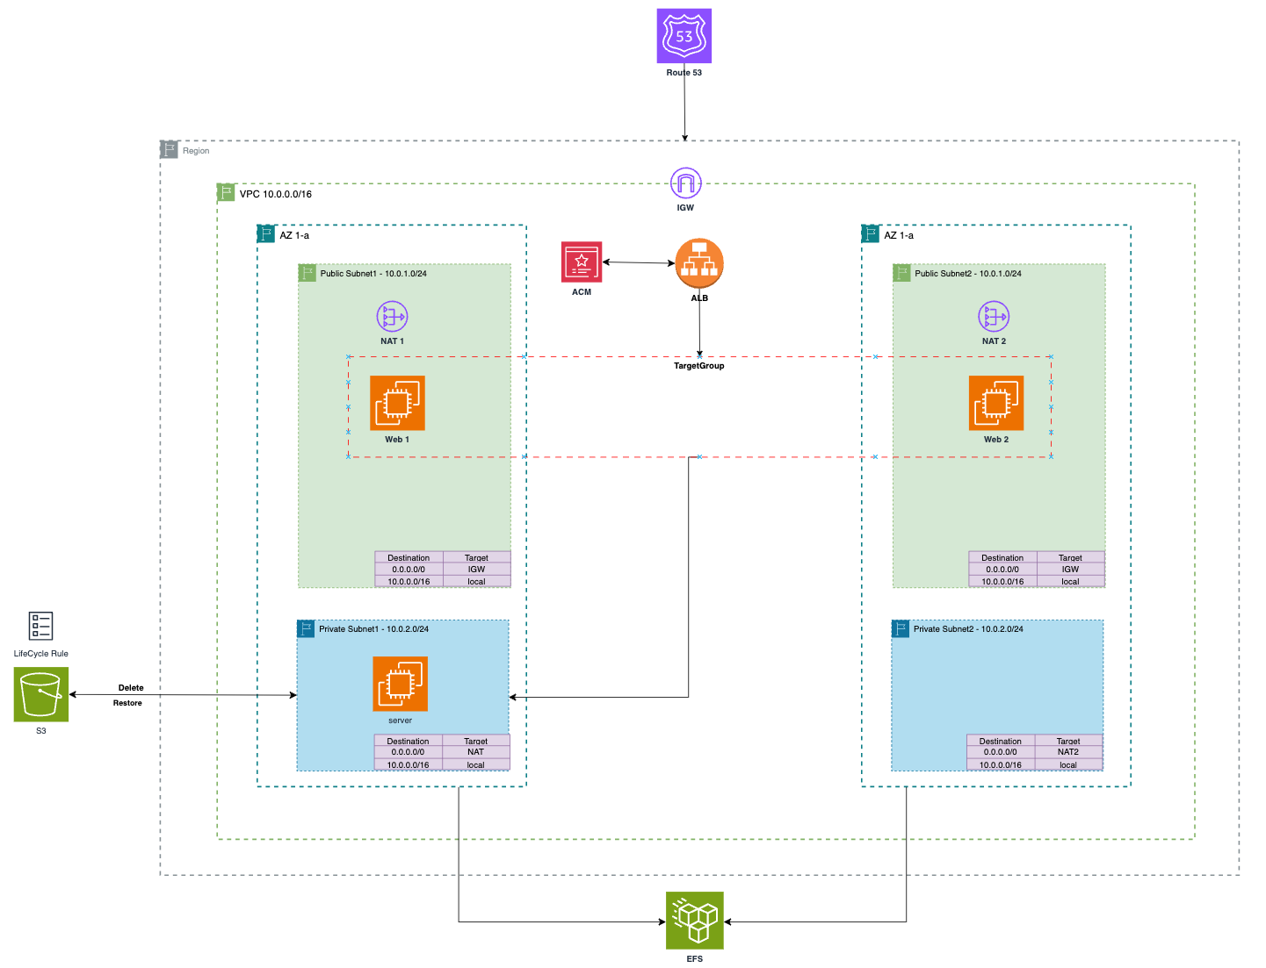
http://my-portfolio-alb-180099420.us-east-1.elb.amazonaws.com

Slide 11
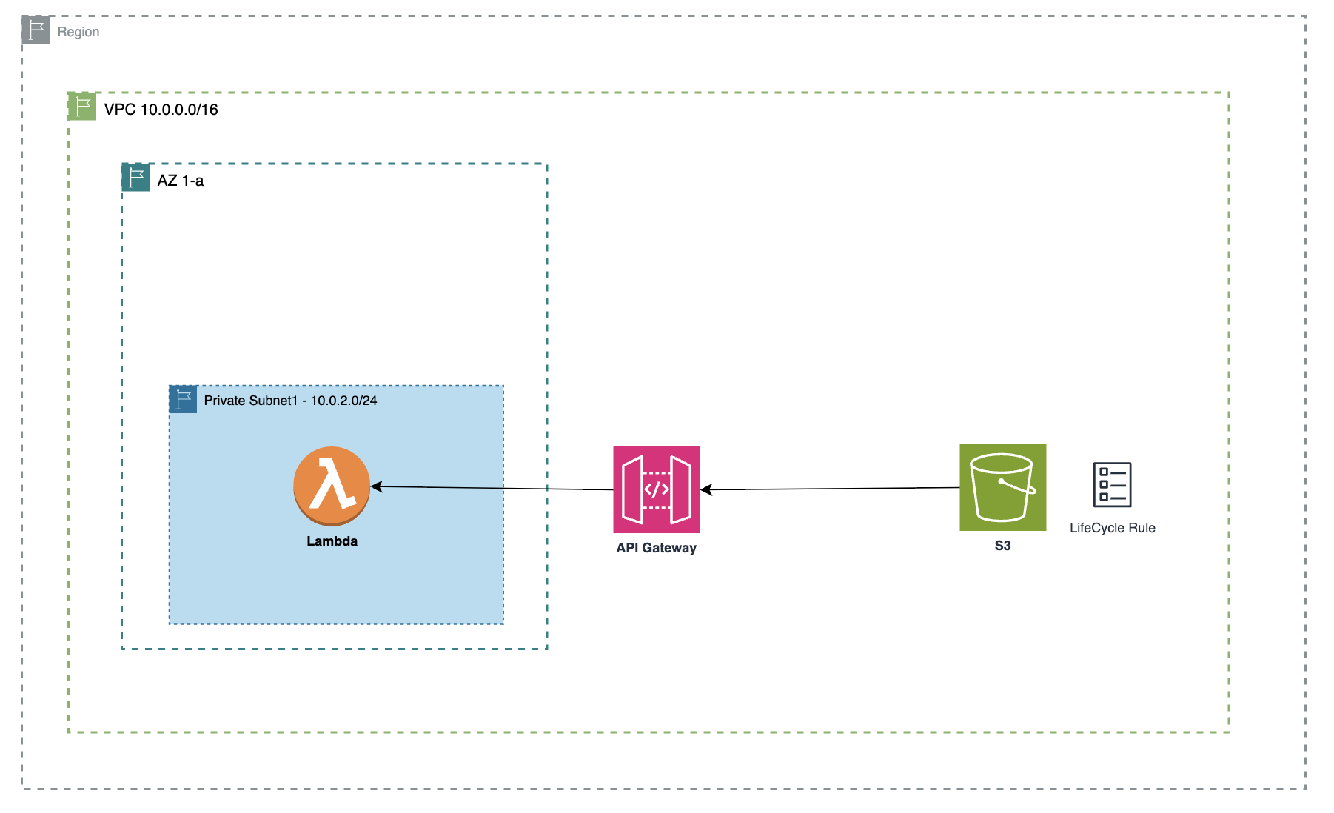
Serverless

Slide 12
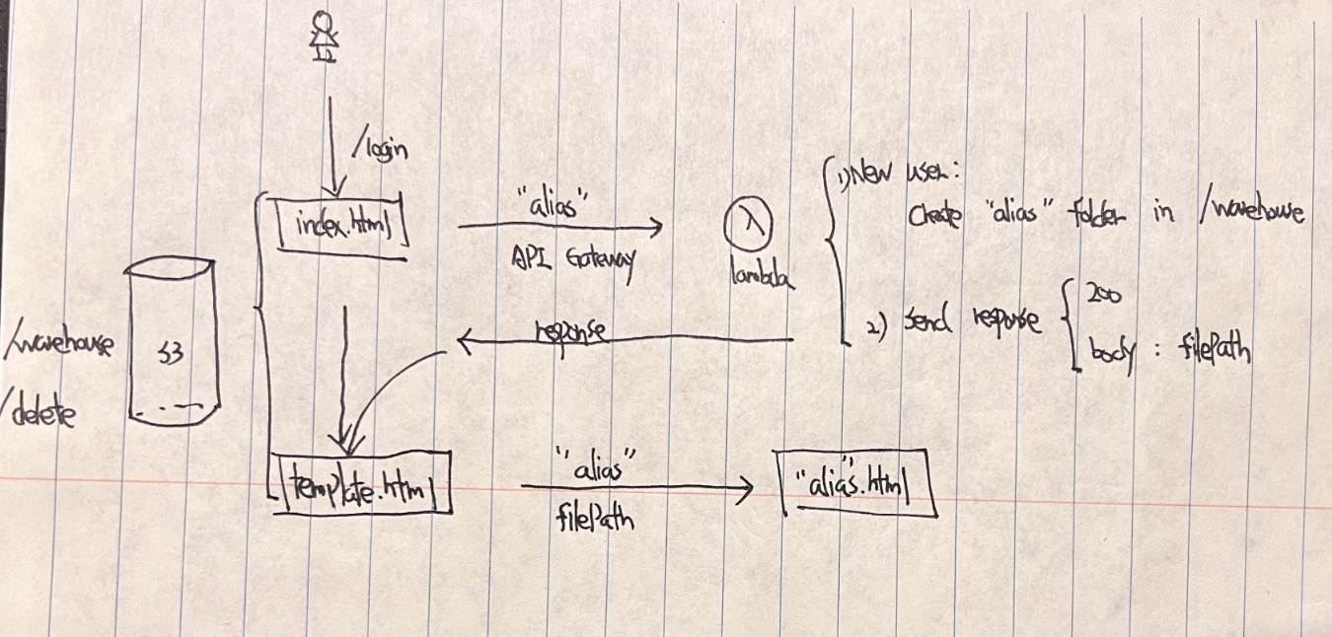
/login

Slide 13
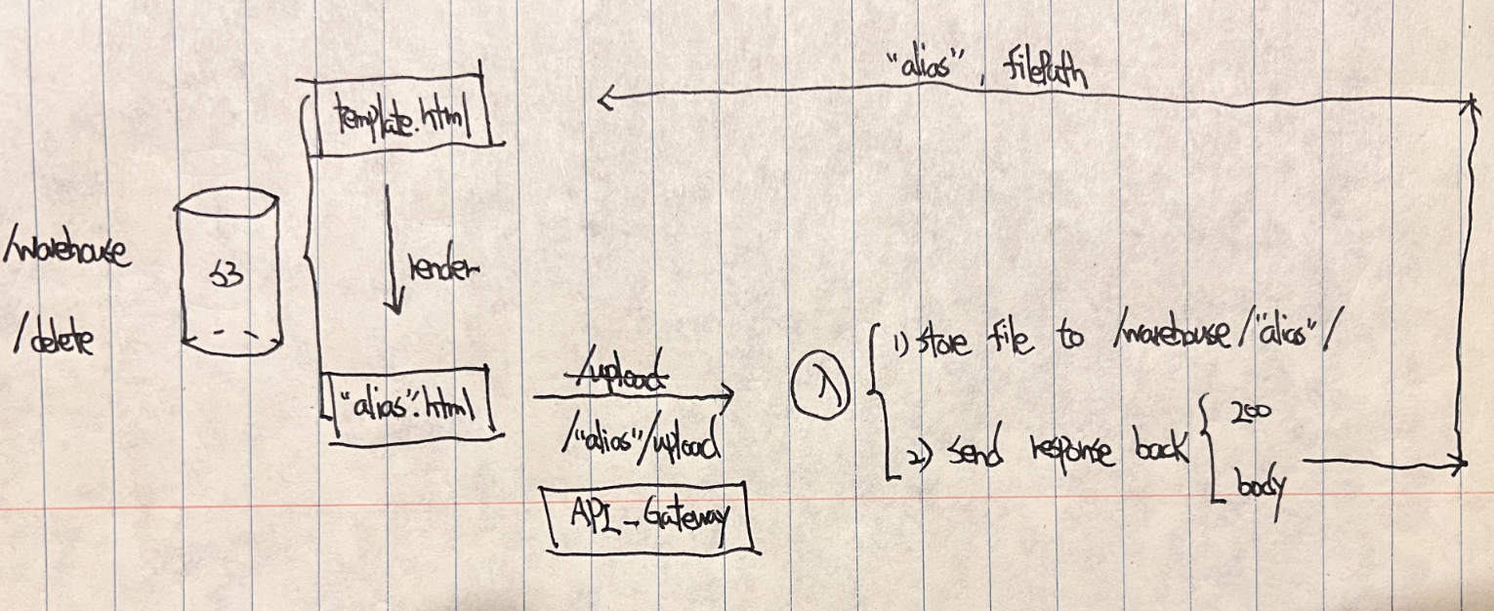
/”alias”/upload

Slide 14
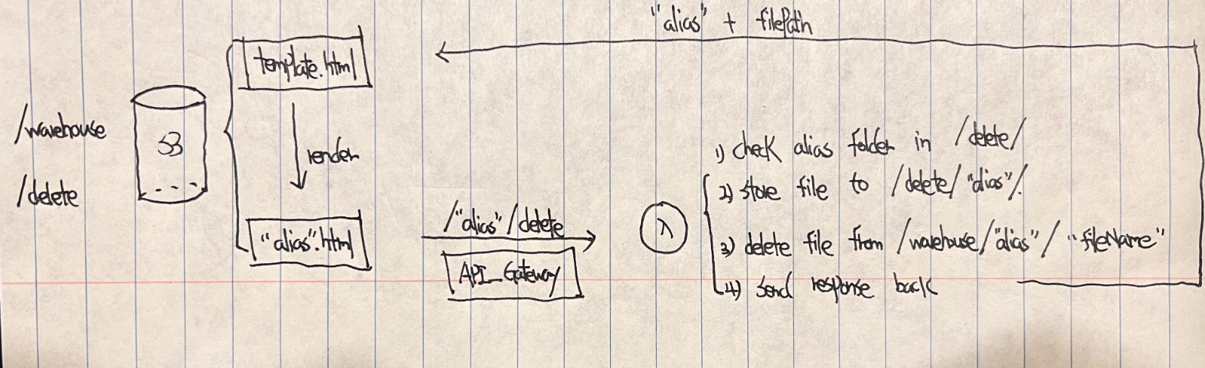
/”alias”/delete

Slide 15
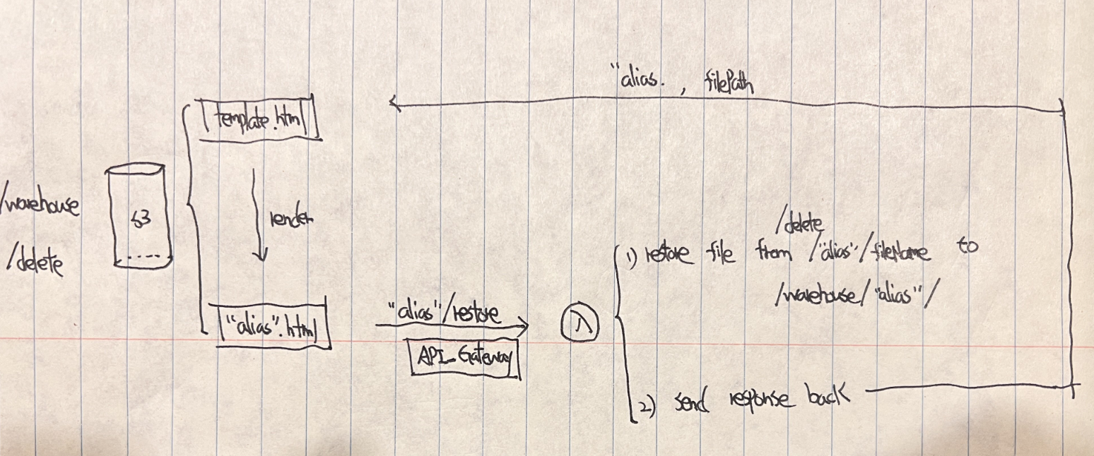
/”alias”/restore

Slide 16
Thank You!
Jason Zhang

